Slide 1
High-Performing Request for Proposal (SOW) for IT Software
WEBINAR

Slide 2
Agenda
Challenges in the IT Industry
Developing a High-Performing RFP
Content & Structure
Putting a High-Performing RFP into Practice

Slide 4
Challenges in the IT Industry

Slide 5
SOW Challenges in the IT Industry
Common Perceptions in IT Software Delivery:
“IT has a high failure rate”
“Software Implementations almost never reach their ‘Go Live’ target on time.”
“Stabilization is a euphemism for fixing all the mistakes that weren’t resolved in scoping and implementation.”
“Scope gaps and change orders are just a normal part of IT delivery.”

Slide 6
SOW Challenges in the IT Industry
CHAOS Report published annually by Standish Group
Based on 3 decades of IT project compilation:
46% of projects are Challenged: complete and operational but over-budget, over-schedule, AND offers fewer features than specified
26% are Failed: cancelled at some point or not used after being implemented.

Slide 7
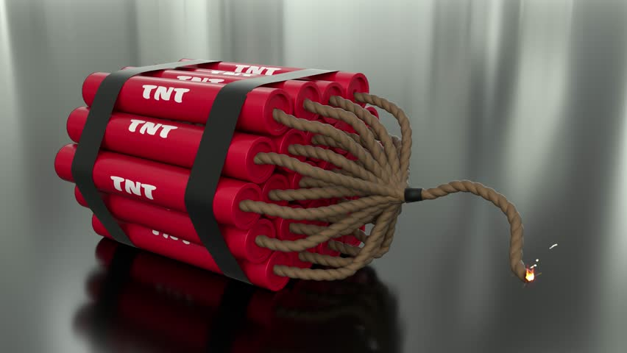
SOW Challenges in the IT Industry
Feedback from 600 U.S. Business & IT Executives (Geneca 2011)
75% admitted their projects were either “always” or “usually” doomed right from the start.
61% of projects take longer than anticipated.
57% are not considered a success.
80% admit they spend at least half their time on rework.

Slide 8
SOW Challenges in the IT Industry
Oxford University & McKinsey studies 5,400 IT Projects
17% average shortfall in benefits achieved vs. original plan
66% average cost overrun. 33% average schedule overrun.
17% of projects perform so poorly that they threaten the very existence of the company.

Slide 9
SOW Challenges in the IT Industry
Feedback from IT Project Professionals (Kappelman et al. 2006)
50+ Early Warning Signs of IT Project Failure grouped into 3 categories:
People Risks: including top management, project management, project team members, SMEs, etc.
Process Risks: 5 project management processes and their deliverables (requirements, scheduling, communications, resources, & change control)
Technology Risks: ailments of the IT System itself, including inherent product risks, scalability, size, complexity, functionality, etc.

Slide 10
SOW Challenges in the IT Industry
Feedback from IT Project Professionals (Kappelman et al. 2006)
The 50+ Early Warning Signs of IT Project Failure were prioritized down…
The “Dominant Dozen” Early Warning Signs:
The Top 12 were all People and Process Risks.
None were Technology Risks.

Slide 11
Scenario #1: Scope is Above Budget
Client’s Scope
(Cost Proposal is for this!)
(-$ alternatives)
Client’s Budget ($$)

Slide 12
Scenario #2: Intent Doesn’t Match Scope
Client’s Budget ($$)
Client’s Needs
(+$ alternatives)
Client’s Scope
(cost proposal is for this!)

Slide 13
What’s Next?
A High-Performing SOW should be coupled with…
A High-Performing RFP!!! Can further enhance your SOW via:
Ways to evaluate optimal approaches
Ways to solicit innovative ideas
Ways to evaluate gaps and uncertainties that exist in your SOW
Ways to minimize contingencies in supplier pricing
Optimize project budget and schedule constraints

Slide 14
Thank You!
Email me for free copies of…
The Presentation Slides
XPD Approach to IT Delivery
Early Warning Signs in IT Projects
The Full Impact of Software Implemenation
EXAMPLE – Capital Project Mgmt Software
EXAMPLE – Asset & Work Mgmt Software
brianlines@ku.edu

