Slide 1
RFP/RFQ DEVELOPMENT
Fair, Open, Transparent
Brian Lines, Ph.D
Assistant Professor
University of Kansas
Dept. of Civil, Environ. & Arch. Engineering
brianlines@ku.edu
785-864-6503

Slide 2

CONTRACT
AWARD
0
SCOPE
DEVELOPMENT
PROCUREMENT & SELECTION
PRE-AWARD
CLARIFICATION
PERFORMANCE
METRICS

Slide 3
RFP Development
Keep it Short – Proposal Page Limits
Focus on the People – look beyond the Logo
Keep it Open – Minimize “Pre-Selections”
Treat Price Fairly
Compete on Expertise – Risk & Value
Take-Away Tools
Sample Interview Questions
Price Proposal Template for IT
RFP Report Card

Slide 4
Keep it Short:
Proposal Page Limits

Slide 5

QUESTION
Written Proposal Submissions
What do these look like?
What type of information do vendors typically include?

Slide 6
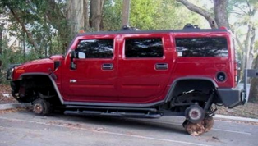

Keep it Short
2-3 pages each
6-12 pages in total
+ 20min Interview
Focus on what shows differences Who does this favor?

Slide 7
What are we trying to accomplish?
Scope:
Hire the right green circle
Scenario 1
Scenario 2

Slide 8
Keeping it Short
Define page limits for each evaluation category
Wherever possible, the CLIENT should provide a template for vendors to complete.
  What information do you want to see???

Slide 9
Advantages
Templates make it easier to compare side-by-side
Faster & less cumbersome evaluations
More consistent criteria over time (strategic!)

Slide 10
Focus on the People:
Look Beyond the Logo

Slide 11
QUESTION
Interviews
How is this traditionally performed?
What do you commonly learn?

Slide 12
“The Greatest Risk we always face is how to accomplish all the things that our sales team promised we could do.”

Slide 13
Focus on the People
Get Team Members Up Front (ID in Proposal)
15-30min Interview
Interview is One-on-One, No Notes
Key Question:
On the whiteboard:
Quickly layout the project/service (from start to end) with the following:
  Identify the major activities with approximate durations
  Identify the greatest risks and where they are on the timeline
  Identify what you need from the client & when you need it
Notes:
How do you currently run interviews? Or is it more like a presentation?
How much time does it take?
What do you REALLY get out of your typical interviews?.... or is it more like a “dog and pony” show – look nice, but no substance
“I feel like they are using really great words… but I have no idea what they are talking about.”
Is it structured and follow a process – again, FAIR OPEN TRANSPARENT
What causes you to have the “best project” [RFP or the “people” “really good team”]?

Slide 14

Interviews
Q&A Interview, NOT a presentation
Individuals will be interviewed separately (published in the RFP):
  Regional Manager / District Manager / Financial
  Project Manager / Lead Eng / Lead Arch / Account Rep
  Site Superintendent / Design Arch / On-Site Lead
  Key Subs or Technical Specialties
A standard set of questions for each role
Interviews typically last 15-30 minutes per individual
Notes:
14

Slide 15

Interview Questions:
Identifying Expertise
Why did your company select you for this project?
Describe a similar project you have delivered.
Draw out your project plan & major milestones.
  Identify major risk items and where they occur on the project timeline?
  How will you minimize the risks on this project?
  Identify where critical decisions will need to be made.
  Identify where any critical involvement will be needed from the Owner
Additional: other project-specific questions.

Slide 16

Key Personnel Interviews
Goals:
  Meet the critical personnel that are being assigned to the project
  Identify if personnel have experience and have thought about this project
  Identify if the personnel can think ahead and minimize potential risks
Notes:
16
16

Slide 17
Key Personnel Interviews
Goals:
  Meet the critical personnel that are being assigned to the project
  Identify if personnel have experience and have thought about this project
  Identify if the personnel can think ahead and minimize potential risks
Notes:
17
17

Slide 18
What does an expert look like?
Able to synthesize.
Has a plan.
Thinks in the best interest of the people and the project.
Speaks in terms of metrics.
It’s as if they’ve already done it…

Slide 19
Advantages of 1-on-1 Q&A Interviews
Meet the actual team of “doers”
Strip out the marketing dog-and-pony show
Job interview format gives greater understanding of the team, resources, scope
Much higher degree of honesty

Slide 20
Interview Comments
“I have no idea why I am here today”…“My boss called me last night and told me to show up for this interview” - $10M Project
“I have qualifications up the wazoo!”
“You do understand that I didn’t write the Proposal. The Proposal was prepared by our business development staff.”
“I am not currently employed by this company, but if we win this project, they will hire me” - $80M Project
“There is no risk on this project” - $5M IT Project

Slide 21
Interview Comments
“I apprenticed under the greats of the industry and can basically trace this lineage back to Nikola Tesla.” - $60M Hydro Generator Overhaul
  “I might be overcommitted by my management because they like to put my resume on proposals. There are not a lot of me out there. I am being very honest with you.” - $60M Hydro Generator Overhaul
  “I have never managed a project of this size/scope” - $30M Project
  “The greatest risk that I always face is how to accomplish all of the things our sales team promised we could do” – Cleanroom Design

Slide 22
Software Verifications
Focused verification of software functionality (not a traditional demonstration)
  Additional detailed demos will be performed later with the selected Vendor (Pre-Award Clarification Phase)
The purpose of this verification is to:
  View an actual installed and operating system
  Identify how well the end users can use the system
Will occur in parallel with the Interviews.
Verifications will NOT exceed 1½ hours
A detailed timeline and script will be provided in advance.

Slide 23
Demonstration Format
Proposer must identify at least one (1) end user that is currently using a product/system that is similar to the product/system being proposed.
Proposer will be responsible for scheduling approximately one (1) hour with the end user to perform the demonstrations.
The end user will demo the product based on the requirements in the predetermined script.
Proposer can travel to the end user’s site to setup and establish an online, real-time webcam and microphone, along with a web application that will allow the Evaluation Committee to view the demonstration (such as WebEx, GoToMeeting, Adobe Connect, etc).

Slide 24
Keep it Open:
Minimize
“Pre-Selections”

Slide 25
“Pre-Selections”
Public & Private Sector:
Do your evaluation teams ever seem to have favorites?
Private Sector:
Do your business units like to trim down the list of who gets the RFP/RFQ?

Slide 26
Open Competition
Invite as many qualified firms as possible (within reason)
When in doubt, extend the invite
Have confidence that the evaluation process will enable the cream to rise.
Our experience is that the industry will “self-select”

Slide 27
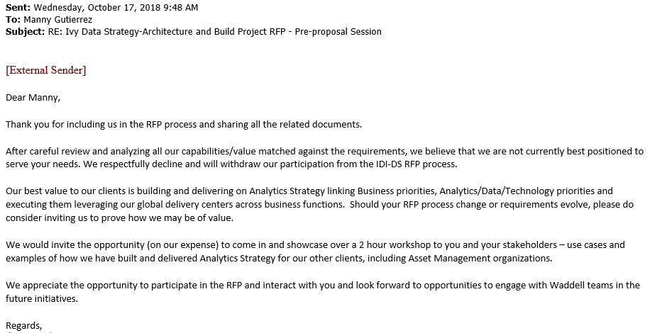
Project
Client

Slide 28
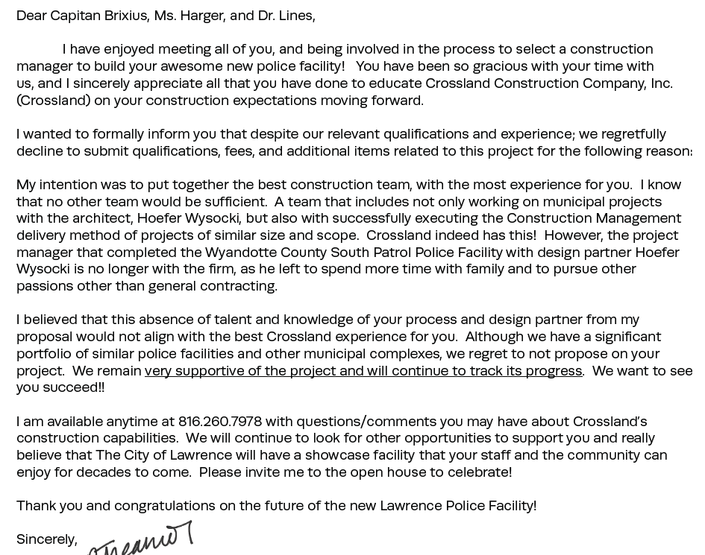
Recent “No-Bid” Example
project
Vendor
Arch Firm
Vendor
Most similar project
Arch
Firm
Vendor
Vendor’s
The client
project

Slide 29
Treat Price Fairly

Slide 30
Treat Price Fairly
If a price evaluation format is not known, the RFP does not get released.
  Goal is apples-to-apples price evaluation (even if cost drivers are different from vendor to vendor)
If possible, limit the weight of price for major RFPs
  The Center for Procurement Excellence (CPE) recommends a max. of 35% for any individual evaluation category
Two envelop evaluation philosophy
Numerical Evaluations

Slide 31
Advantages
Structured price proposal format:
  Avoid the pleasure of multiple cost clarifications
  Avoid the “oops” of incorrect assumptions
Limit the weight:
  Any more than 35% begins to default to a price-based selection.
Two envelope evaluation philosophy
  Evaluate qualifications in a fair manner
Numerical Evaluations = no “voodoo” math or ratings

Slide 32
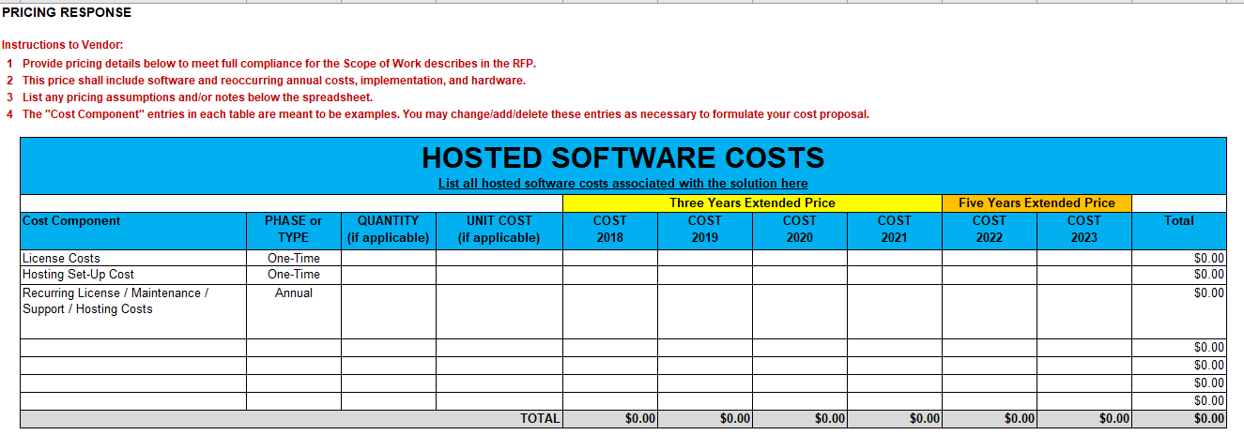
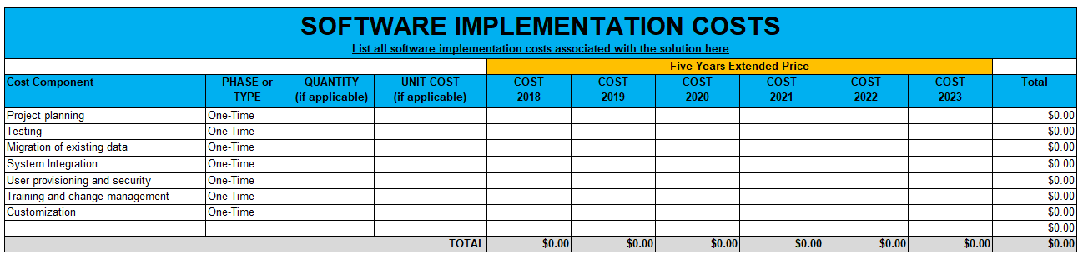
Example: Price Proposal Template for IT Software Projects

Slide 33
Compete on Expertise:
Risk & Value

Slide 34
4. Compete Expertise: Risk & Value
Risk & Value as the Primary Written Submittals
Risk
Assessment
= plan for critical scope elements & potential roadblocks
Value Added
= additional expertise beyond requirements
Notes:
Lots of ways to do this… this is how we’ve typically done it.

Slide 35

Non-Controllable Risk
“Points of Departure” within the Design/Implementation process
Solution:
Available water pressure will not be known until 3-4 weeks into the project schedule (due to required excavations)
There are 3 potential outcomes upon investigation:
1) Adequate pressure available: No change in building parameters
2) Inadequate water pressure: Impact to some building parameters such as size and/or quality of finishing, etc.
3) Worst-case of no water pressure available: substantial underground work, tanks, etc. Significant impact to building size & finish level, resulting in a reduction of project scale.

Slide 36
Custodial Services
Cleaning Service Levels across City Sector
Plan 1:
We will leverage our world-wide network of the most qualified suppliers to ensure our service is tailored to meet the unique needs of each space on a building-by-building and user-by-user basis.
Plan 2:
Our workloads and service plan are built to meet the stipulated APPA levels (daily staffing 22 staff/day at 1/ 22,000m²), exceeding RFP mins.
High occupancy, high traffic buildings (i.e. Van Vliet, CAB, HUB) have a productivity rate of 305 m²/person/hour.
Low occupancy, low density, low traffic buildings (i.e. Assiniboia Hall, Triffo Hall, Arts Building) have productivity rates of 530 m²/person/hour
Each building will have a dedicated working supervisor.
Our work plan also dedicates 3 FTE to the carpet care program and 4.5 FTE to the floor care program
Night staffing and product usage estimates address floor-care targets
Boilerplate Marketing Content
NOT a Plan
Notes:
Project-specific
Actionable approaches / means and methods
Differentiation

Slide 37
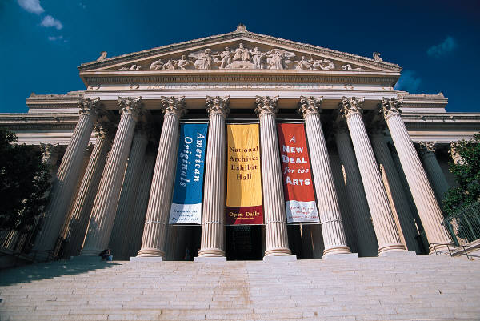
Example of Capability
Minimizing Noise from Demolition
Transfers Risk to the Client!!!
☹☹☹
Plan 1
  We will work with the user to minimize the impact of noise from demolition.
Plan 2
  We have planned to demolition during off hours and weekends. This will have a slight impact on our cost (less than 1%), but the impact to customer satisfaction justifies this.
  We will also install rubber sheets on the floors to diminish noise and vibrations.
  Both solutions can be performed within your budget.
  Both solutions have been used on previous projects with high customer satisfaction (9.4/10).

Slide 38
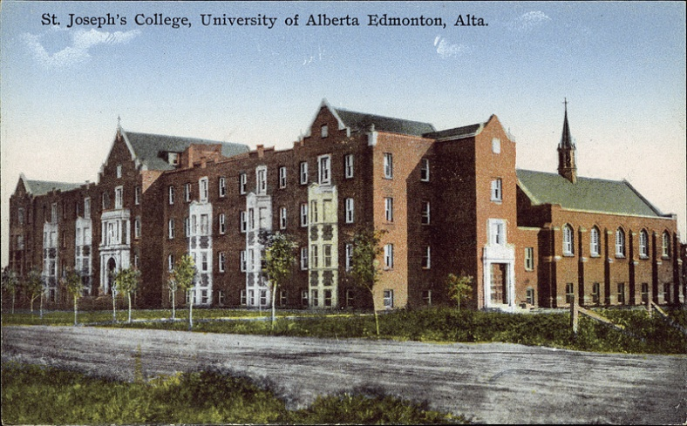
Example of Risk Solutions
Risk: Owner’s Budget (DB Residence Hall)
Solution 1
  By optimizing building location, using a hybrid design, and exploring strong fundamental design processes will provide an optimum solutions.
  As design progresses, continuous verification of the budget will be utilized to ensure success.
Solution 2
  The owner can be assured the budget is not a risk.
  Our world class team has connections to a wide range of high performing suppliers to ensure you always get the best prices so that the budget will be met.

Slide 39
Example of Risk Solutions
Risk: Owner’s Budget (DB Residence Hall) contd.
Solution 3
Budget cannot accommodate program requirements.
Options to meet the budget & deliver required beds:
  Remove underground parkade ($2,054,717 deduct)
  Reduction in certain finishes, such as wall panels vs. dry wall ($67,000 deduct)
  Design efficiencies: adjust net-to-gross ratios in targeted areas of building program, i.e. hallways, common spaces ($1,686,149 net savings)

Slide 40
Example of Risk Solutions
Risk: Owner’s Schedule
Risk 1 | The project schedule is quite compressed
Solution 1: | Establishing a solid work plan that is embraced by our staff, along with the [Owner] will be important to offset delays

Slide 41
Example of Risk Solutions
Risk: Owner’s Schedule
Solution 1
  Compress design development to quickly produce CDs.
  Mass hoarding of bunker structure to minimize impact of weather.
  Project award by Oct. 1 enables excavations to be complete before December holidays and minimizes freeze impacts.
  Construction sequencing: once main floor steel stud framing structure is complete, M&E subs can work on deck level above while additional sub-trades are working on the M&E rough-in and finishing work below. This will reduce schedule time significantly.
  Multiple VA options to minimize schedule constraints, such as:
    Alternate interior finishes critical path reduction by multiple months reduce this trade by multiple months by switching to a partition system
    ($1.6M project budget impact – see Value Add #2 for full details)

Slide 42
Risk Assessment
Risk: Loss of Radio Flagship in Major Market & Revenue Generation
Solution 1
  We will work very hard to maintain excellent affiliate relationships.
  If we lose a radio station (e.g. it changes its format) we will move quickly to replace the lost station. If we cannot quickly replace a flagship station, we can be very creative and could even consider purchasing all local inventory from a new flagship station.
Solution 2
  In the past 10 yrs, on over 50 accounts, 7 radio stations format changes have occurred. The following solution is optimal.
  We own and will maintain two radio contracts covering the area, where signals can be switched if required. The flagship station will be the station with the stronger signal and greater coverage.
  If a station is lost we will have a equal replacement within 2 months. If within two months a replacement is not contracted we will purchase inventory from another station or discount the cost of an inventory purchase and add it to our payments to the Owner.

Slide 43
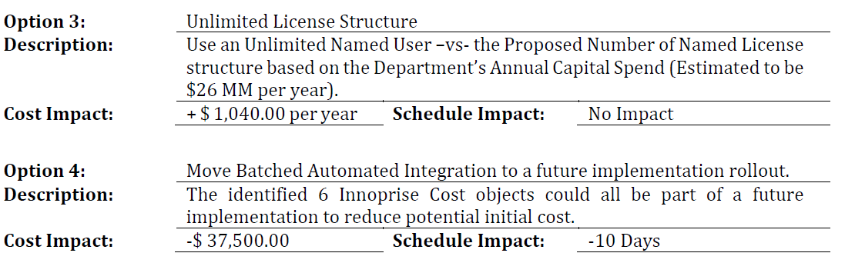
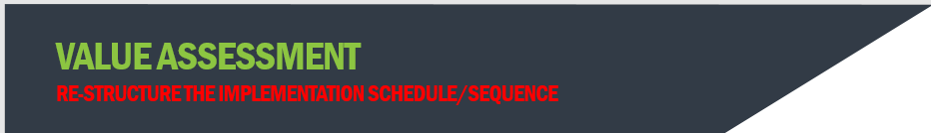
Value Assessment
Opportunity to benefit the project

Slide 44
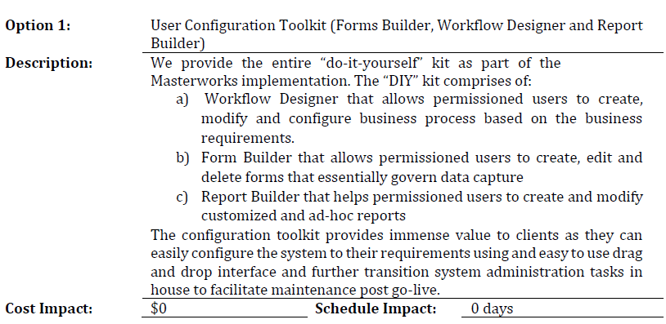
Value Assessment additional functionality (included in base proposal at no added cost)

Slide 45
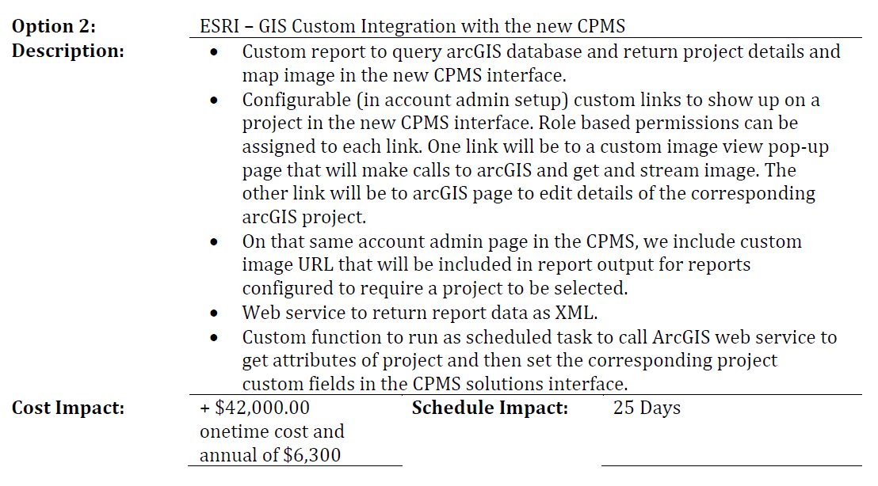
Value Assessment additional integration capabilities

Slide 46
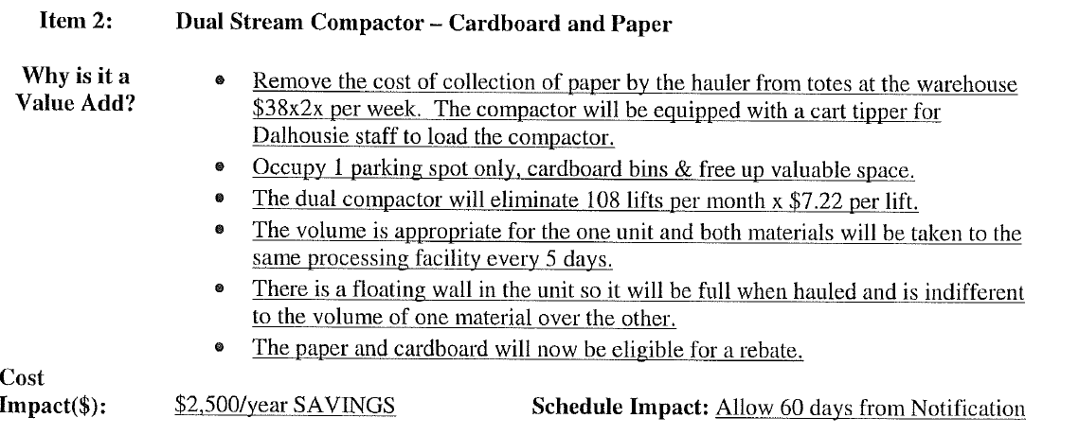
VA: Waste Management
(Integrate New Technology)

Slide 47
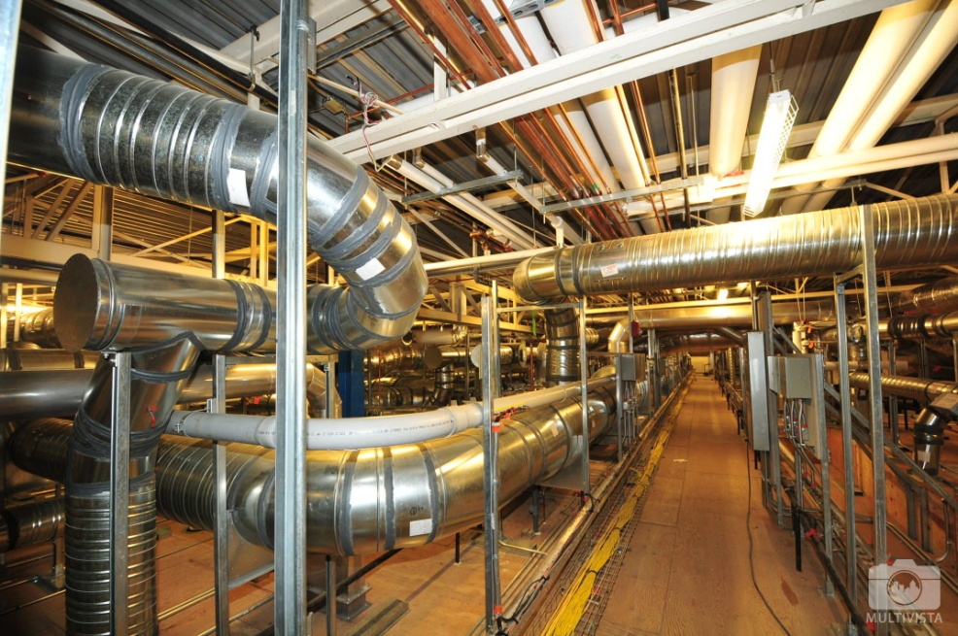
Value Assessment Examples
“Did you actually mean…?”
Example: Air Duct System Improvements
In lieu of using redundant dual duct air systems (shown in bridging documents), a design solution is proposed to substitute redundant variable air volume (vav) systems with reheat
We believe the rationale for using dual duct was to eliminate the potential risk of having a wet heating system leak through the ceiling into the production areas
With the proposed creation of an interstitial service space, the risk for leaking of the wet heating system is mitigated, servicing space is increased, control complexity is reduced, and capital cost is mitigated.
Cost ($): ($158,000) Savings
Schedule Impact: N/A
Notes:
An example of the consultant using their expertise to ask the owner: “Did you actually mean this? This solution will work better, but is a change in scope”

Slide 48
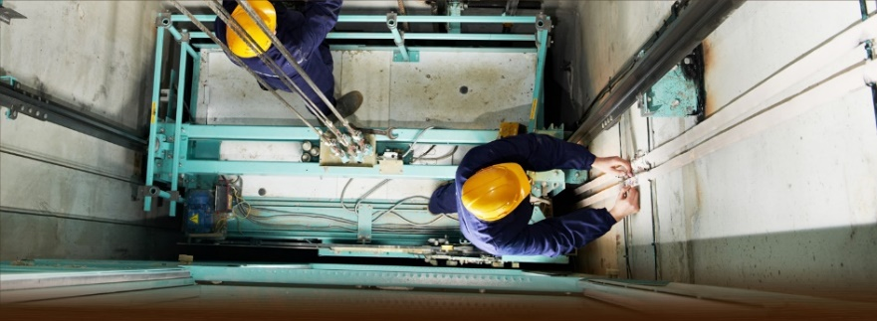
ELEVATOR MAINTENANCE
Optimize an Overly Prescriptive Scope
The amount of elevators included in the Scope would not warrant a dedicated mechanic.
Savings could be realized if this language is adjusted.
Levels of service would not be adversely effected by having a dedicated mechanic who also has other buildings in close proximity to the site.

Slide 49

Value Assessment
Option to Reduce Project Cost:
Instead of purchasing “Named Licenses,” the Agency may want to consider purchasing “Concurrent Licenses.”
In a “Named Licensing” model, the software designates a license per user and only that particular named user can use/access the license. If that named user is in meetings, on vacation, or not using the system, the license is not utilized.
In a “Concurrent Licensing” model, the server keeps track of the total number of licenses and loans the licenses to users as they log in. If a user is inactive, the server releases the license and allocates the license to the next user.
The advantage is that the Agency is not required to purchase licenses that are not being used, which can result in approximately 25% savings in cost.

Slide 50
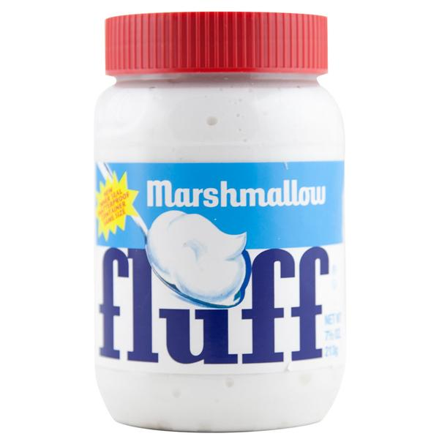
Boilerplate Content
  “We will work with the owner…”
  “We have ## years of experience…”
  “Our team that includes the most detailed, prequalified, and extensive list of subs/suppliers from around the world.”
  “Our team has extensive experience in… [Lean methodologies, JIT principals, modular construction applications, etc.]”
  “Our company values are…
      …Creating value through people, respect, and collaboration.”
      …to utilize a Total Team Approach.”
      …that our people are our greatest asset.”

Slide 51
Contractor’s Risk Mgmt Ability Improves Project Performance
  N=133 projects

Slide 52
RFP Development
Keep it Short – Proposal Page Limits
Focus on the People – look beyond the Logo
Keep it Open – Minimize “Pre-Selections”
Treat Price Fairly
Compete on Expertise – Risk & Value
Take-Away Tools
Sample Interview Questions
Price Proposal Template for IT
RFP Report Card

Slide 53
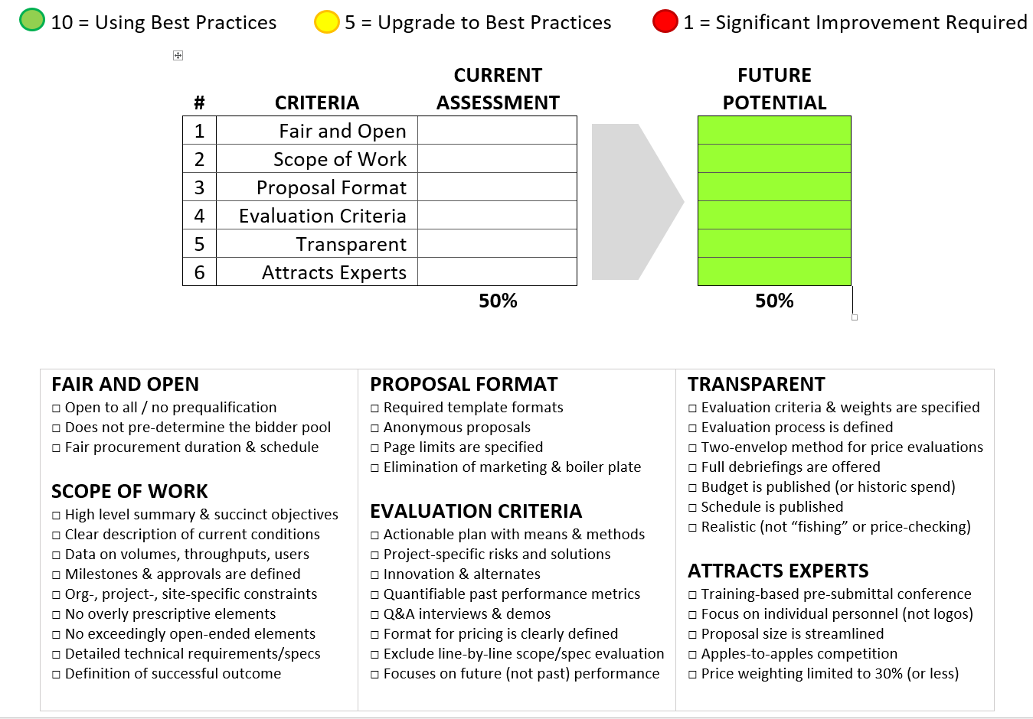
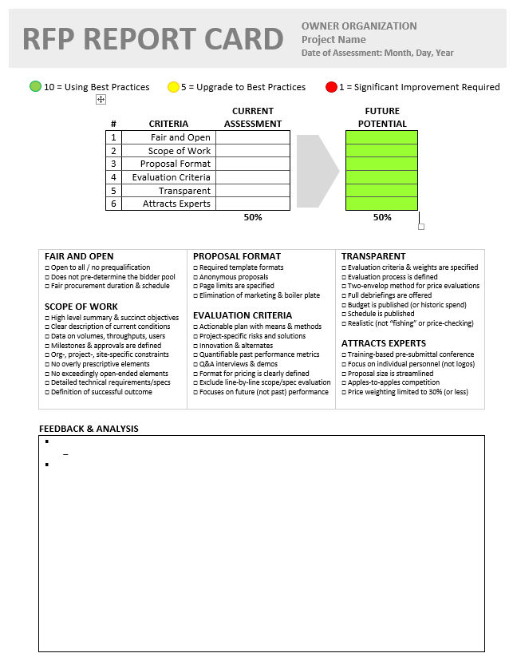
RFP Report Card

Slide 54
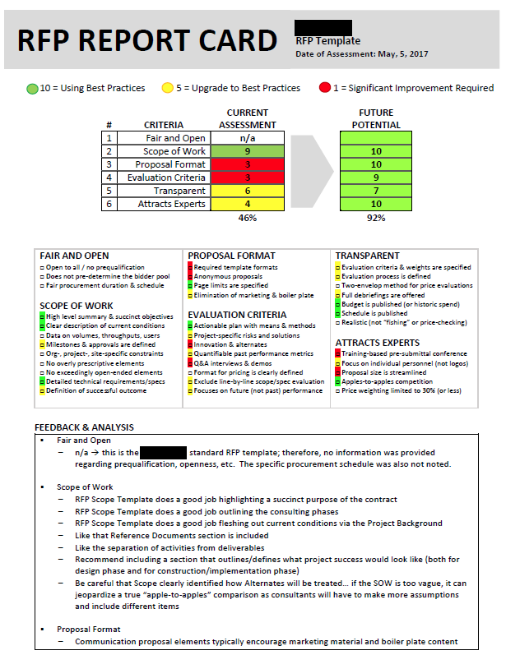
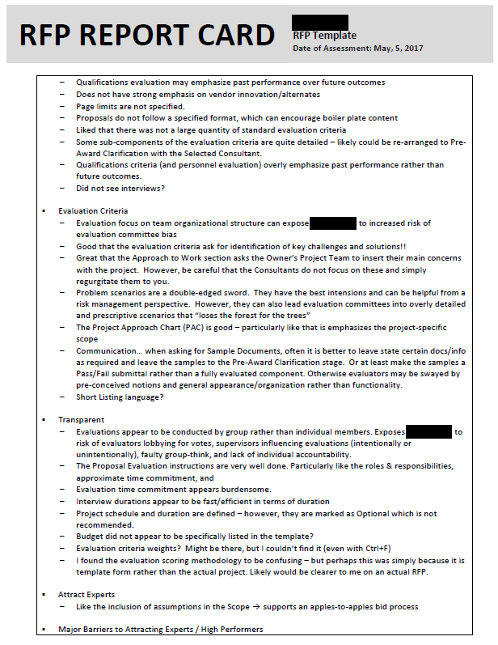

RFP Report Card

