Slide 1
PROJECT SCOPING:
Developing an Effective
Scope of Work
Brian Lines, Ph.D
Assistant Professor
University of Kansas
Dept. of Civil, Environ. & Arch. Engineering
brianlines@ku.edu
785-864-6503

Slide 2

CONTRACT
AWARD
0
SCOPE
DEVELOPMENT
PROCUREMENT & SELECTION
PRE-AWARD
CLARIFICATION
PERFORMANCE
METRICS

Slide 3

Everybody Loves
Writing a Scope of Work!

Slide 4
What Percent of
Scopes of Work
Specifications
Minimum Requirements
RFPs, Contract Docs are 100% Accurate?
Answer:
0%

Slide 5
Outline
How a Poor SOW Causes Harmful Outcomes
Balancing Act: overly prescriptive vs. open-ended
What does an Effective SOW look like?
The “silver bullet” of SOW development
(or, what to do when you don’t know what to do)

Slide 6
Scope Development
Share the Project’s Constraints
Don’t be Overly Prescriptive
Focus on Current Conditions
Include an appropriate Vision Statement
Ask Vendors what they Need
Take-Away Tools
White Paper on “The Budget”
SOW Template
RFN Template

Slide 7
How does a
Poor SOW
Cause Harmful Project Outcomes?

Slide 8

Frustrations with Scoping
Can be very challenging
  What to put in?
  What to leave out?
  How much detail?
  What details?
  Don’t know what you don’t know…?
Users have a hard time preparing the scope
  Too busy
  Too detailed
  Too technical
  Too prescriptive
  Don’t know where to start

Slide 9
Scope of Work / Spec / Reqs
Perceptions of
Owner SOWs
Unclear
Information is missing
Overly prescriptive
Unrealistic
Discourages innovation
The owner is “fishing”
Misunderstands Needs
Procurement is not fair
Impact
Fewer proposals
Low quality proposals
Less qualified team/indivs.
Less competitive pricing
Less consistent pricing
Open to interpretation
Have to believe the vendor
Brings risk to the Owners
Notes:
All starts w scope. Has a huge impact.
If poor and you believe the vendor and hire them.. Then find out not covered… who pays?
Ops groups need to realize this… not important just bc procurement says so. Not bc make sure it’s all included.
→ About attracting the right vendors in the first place!

Slide 10
Balancing Act: Overly Prescriptive vs.
Open-Ended

Slide 11

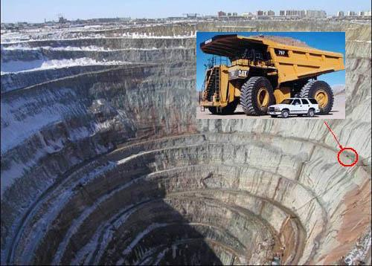
Major Utility Group
Full Technical Specification: “Pls dig a hol”

Slide 12
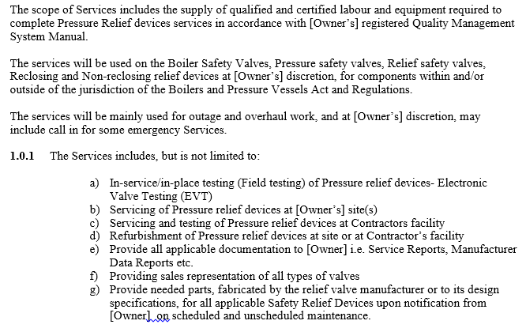
Coal-Fire Plants:
Safety Valve Maintenance Services

Slide 13
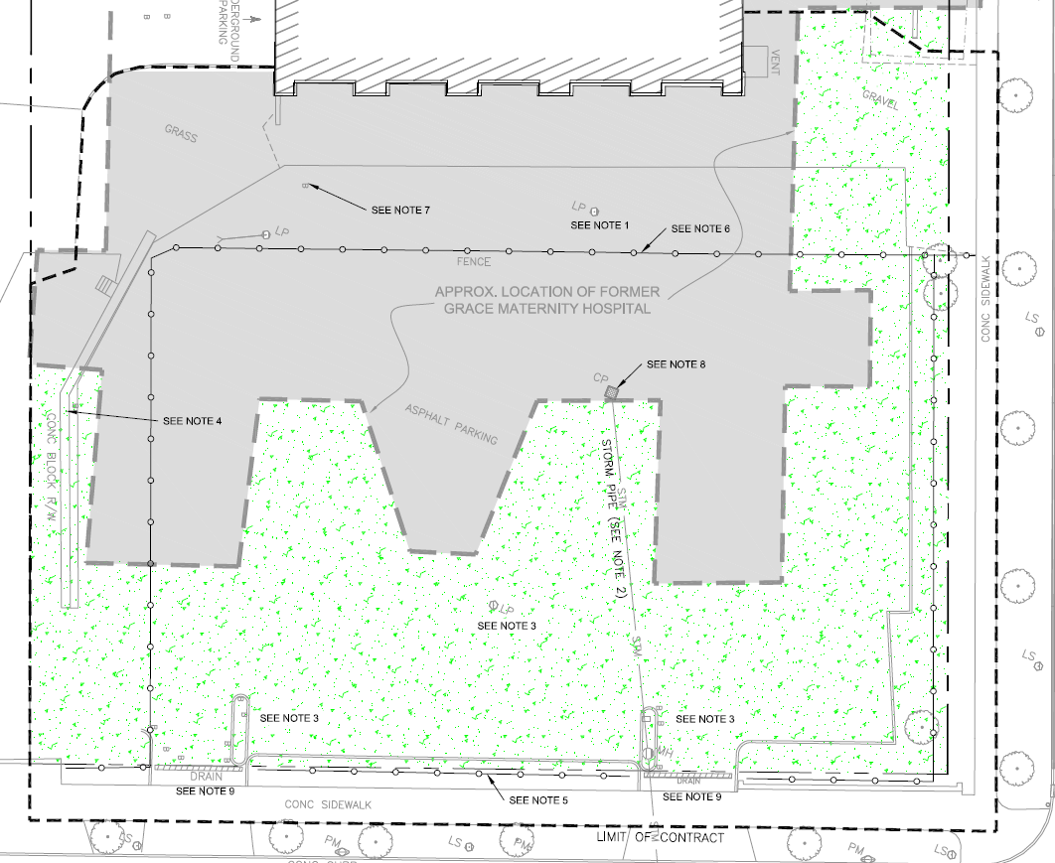
Site Excavation & Remediation
“Silt and sand soil, mixed with debris from the demolition of the hospital, and often underlain by a concrete slab or footings ranging from 1.8 to 3m thick.”
No benchmark to bid to!
“Primarily dark brown/grey silty sand with gravel.”

Slide 14
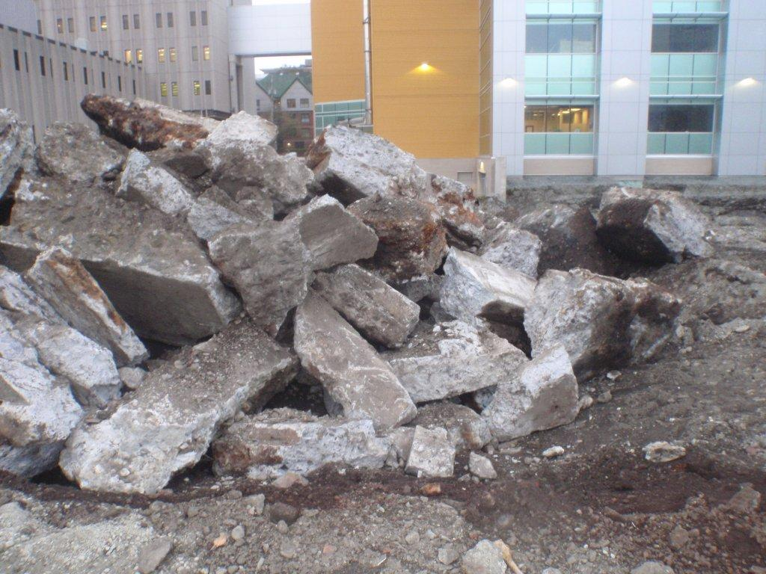
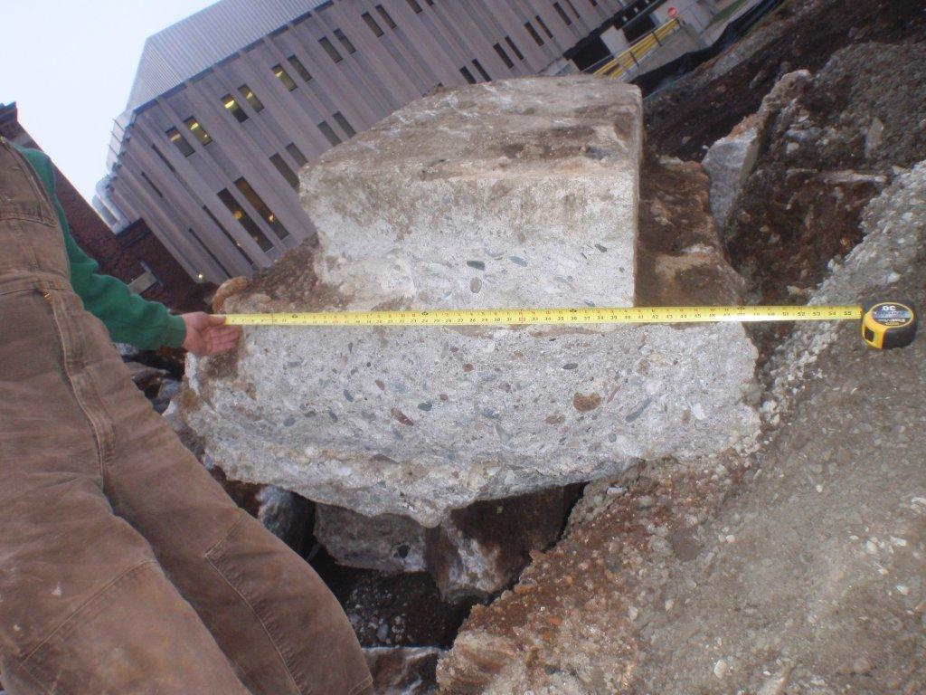
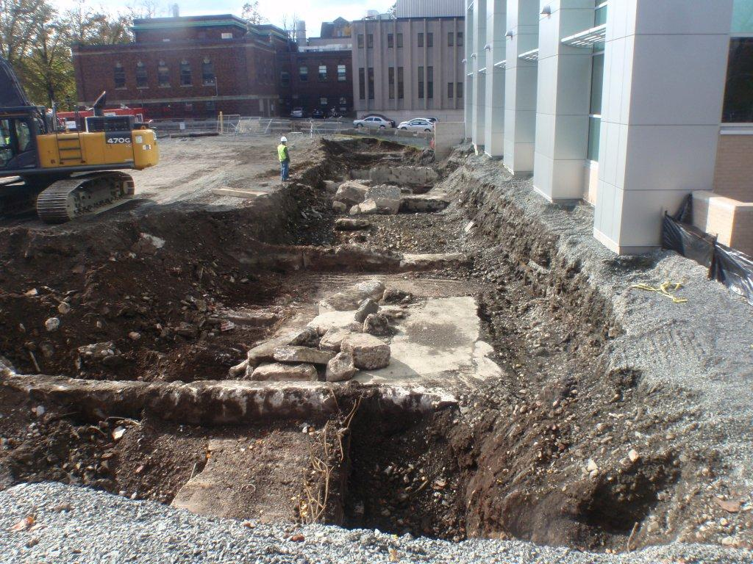
Soil Excavation & Remediation

Slide 15
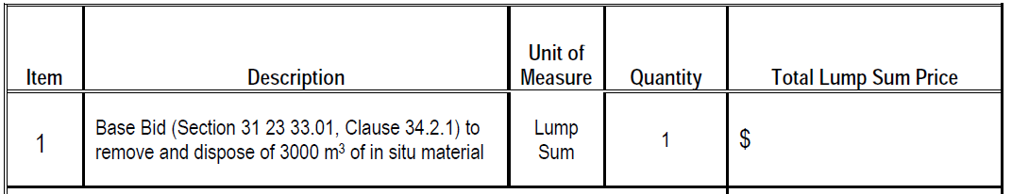
Soil Excavation & Remediation

Slide 16
Should We Provide A Budget?

Slide 17
Concern #1:
Vendors will Inflate their Bids
Owner’s Budget ($$)
Bid Target???
+$
Owner’s Scope

Slide 18
Fear Of Providing The Budget
…Everyone Will Bid $1 Under!
Advertised Budget = $100,000 (but real cost to do the work is $50,000)
  Vendor 1 = $99,999
  Vendor 2 = $99,900
  Vendor 3 = $99,975
  Vendor 4 = $99,500
  Vendor 5 = $99,986
QUESTIONS TO ASK YOURSELF:
What type of vendors would do that?
What can throw-off this strategy?
Who do low-performers care about?
What is a low-performers greatest advantage?

Slide 19
Research DOESN’T show that Providing Budgets = Higher Costs
University of Minnesota
  Issued 248 RFP’s with Budgets
  Total Estimated Budget = $222 Million
  Total Average Proposal = $143 Million (36% below budget)
  Total Awarded Cost = $107 Million (52% below budget)
Dalhousie University
  First project issued with a budget = $500,000
  Only 1 Bidder, Awarded for $284,300 (43% below budget)
Queens University
  HVAC budget = $500,000
  Average proposal cost was $451,000 (10% below budget)

Slide 20
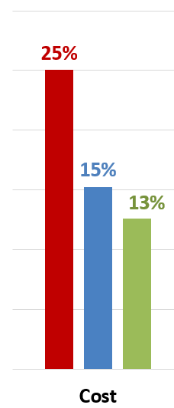
Scope Definition vs. Proposal Variation
Variation among
Competing Proposals
Scope Definition
Poor
Moderate
High
N = 347 projects (1,850 individual proposals)

Slide 21
Releasing the Project Schedule
Design Services for new Interdisciplinary Engineering & Architecture campus building.
#1 = Vendor 4 = 85.9 points
#2 = Vendor 6 = 85.6 points
Cost | 1 | 2 | 3 | 4 | 5 | 6 | 7 | 8 | 9
Price | $1.7k | $1.4k | $1.8k | $1.0k | $1.1k | $1.4k | $1.4k | $1.2k | $1.3k

Slide 22
Scope Development
Share the Project’s Constraints
Don’t be Overly Prescriptive
Focus on Current Conditions
Include an appropriate Vision Statement
Ask Vendors what they Need
Take-Away Tools
White Paper on “The Budget”
SOW Template
RFN Template

Slide 23
Impact of Open-Ended / Unclear Specs on Vendor Proposals
Have to believe the vendor
Open to interpretation
Encourages the minimum
Less consistency in pricing (wide range)
Less competitive pricing (increased contingency)
Discourages Vendors from submitting
Brings you Risk!

Slide 24

Waste Hauling SOW
5,000+ tons of waste collection across an urban region
“An adequate fleet of collection vehicles should be used and maintained by the Proponent… It is the [Owner’s] expectation that collection vehicles designated for service should at a minimum…be less than two years old at the start of the contract”
In order to support accurate measurements towards the [Owner’s] sustainability goals, all vehicles must be solely dedicated to the [Owner] and cannot be used for other sites.

Slide 25
Waste Hauling
Unreleased budget: $321,000 per year

Slide 26

Elevator Maintenance SOW
(campus-wide)
The Proponent shall assign a dedicated maintenance technician to this contract.
This individual must be solely assigned to this contract and will perform all preventative maintenance & major repairs within the building zone.
The dedicated maintenance technician shall be provided with office space within the building zone as their base of operations.

Slide 27
Hydro-Generator Overhauls
Minimum Qualifications:
Minimum 10 years experience
At least 10 projects in procurement and execution of DB contracts.
Experience in working on behalf of both owners and DB contractors must be demonstrated.
Minimum of 5 DB projects in [specific State]
Must have completed 1 DB project working on behalf of a public owner.
Have completed 1 DB project that was not new construction, but was a refurbishment, remodel, or addition to an existing asset in a secure operating facility.

Slide 28
Impact of Overly Prescriptive Specs on Vendor Proposals
“tie the hands” of vendors regarding the work and manner in which it is undertaken
Can significantly increase cost & schedule
Removes flexibility to offer strategies & innovations for the specific environment
Limits the maximum accountability & responsibility vendors have to perform

Slide 29
Scope Development
Share the Project’s Constraints
Don’t be Overly Prescriptive
Focus on Current Conditions
Include an appropriate Vision Statement
Ask Vendors what they Need
Take-Away Tools
White Paper on “The Budget”
SOW Template
RFN Template

Slide 30
Elements of an
Effective Scope of Work

Slide 31
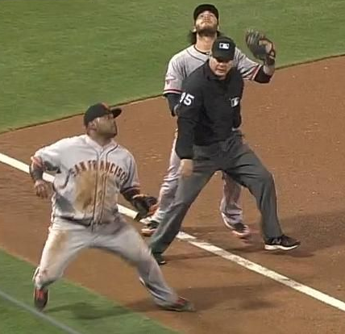




An “effective” Scope of Work
requires the appropriate perspective…

Slide 32
An “effective” Scope-of-Work:
What would an Expert Vendor need (or want) to know?
What will help them provide you with the best price?
What will help them minimize their contingencies?
What will prevent them from walking away?
Notes:
Answer these questions and you automatically have a good SOW

Slide 33
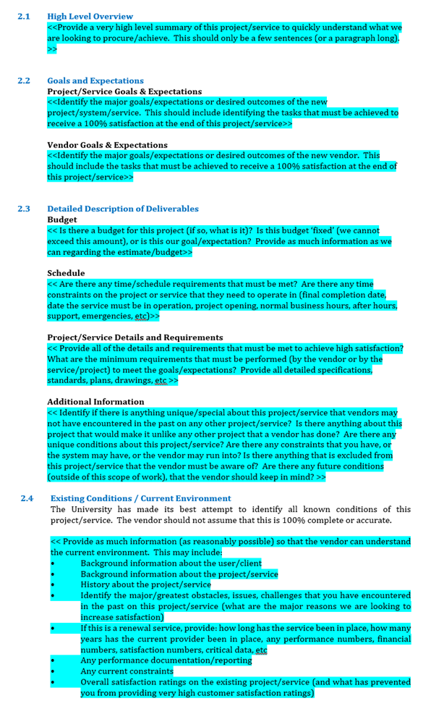
Scope of Work Template
High Level Overview & Objectives
  What would a successful outcome look like?
Existing Conditions / Current Environment
  Current Condition Volumes, Data, Performance
  Current operation, incumbent vendor resources
  A day in the life of…
Description of Deliverables/Reqs/Outcomes
  Budget
  Schedule
  Project/Service Details and Requirements
  Additional Information
4. Project Risks & Concerns

Slide 34
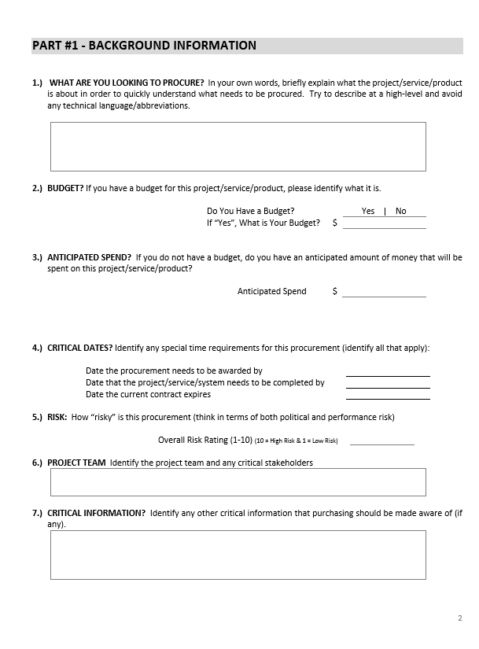
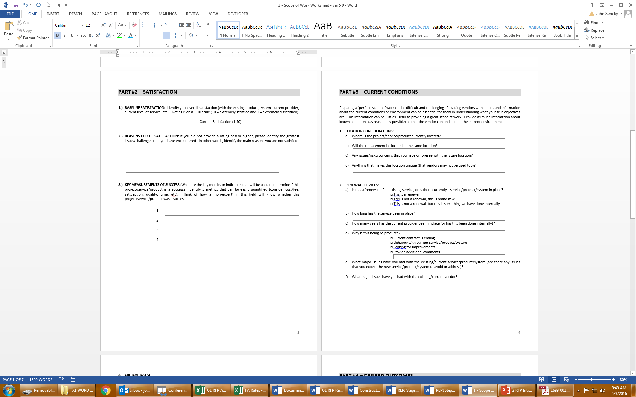
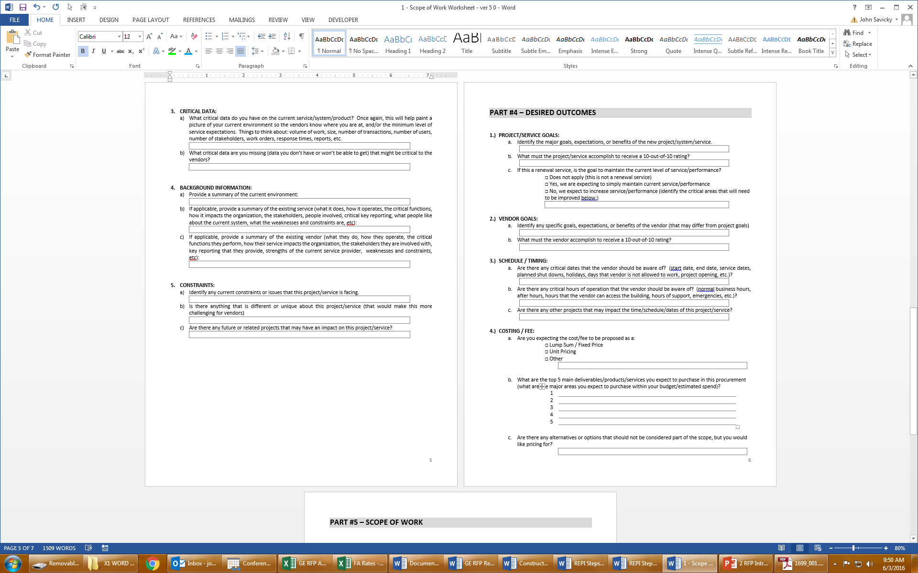
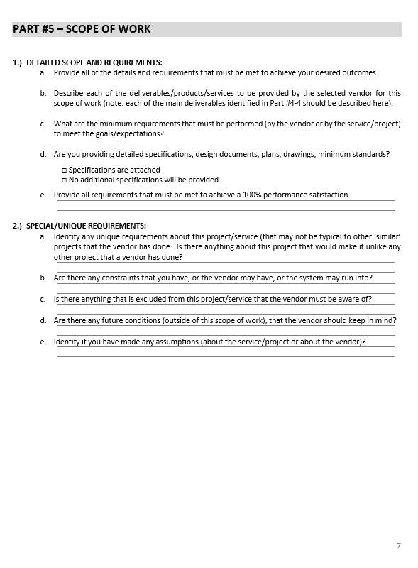
Scope of Work Template
Notes:
Most struggle with where to start and overlook the basis info

Slide 35

Current/Existing Conditions are MOST CRITICAL!!!

Slide 36


Missing a Vision Statement:
Most Common Vendor Complaint

Slide 37
Scope Development
Share the Project’s Constraints
Don’t be Overly Prescriptive
Focus on Current Conditions
Include an appropriate Vision Statement
Ask Vendors what they Need
Take-Away Tools
White Paper on “The Budget”
SOW Template
RFN Template

Slide 38
The “silver bullet” of Scope Development
or, what to do when you (or the business unit) don’t know what to do

Slide 39
Issue an
RFN to the Vendor
Community
But with the RIGHT intentions…

Slide 40
An RFN is NOT…
Surveying general capabilities…
Fishing for data…
Seeing what’s out there…

Slide 41
Questions that an RFN can Answer
What information do Vendors need to develop an accurate proposal with minimal contingency?
  Reduce the # of scope gaps
  Increase the chance of “tighter” pricing
How should the scope be structured (and why)?
What can the Owner begin working on now to facilitate an efficient project once it is awarded?
Other project-specific questions…
Notes:
RFI misperceptions

Slide 42

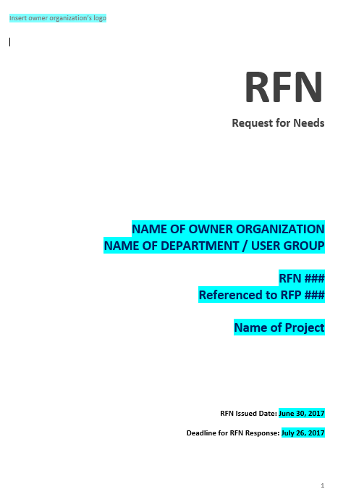
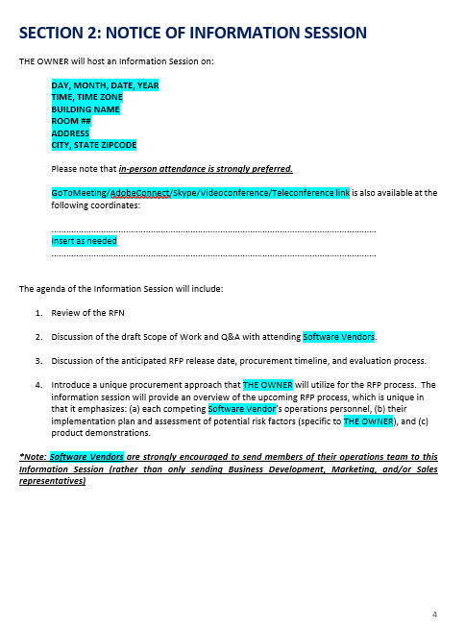



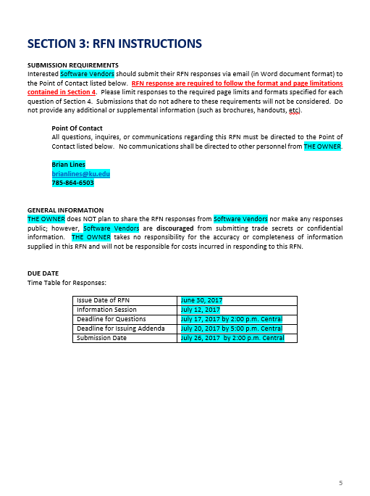
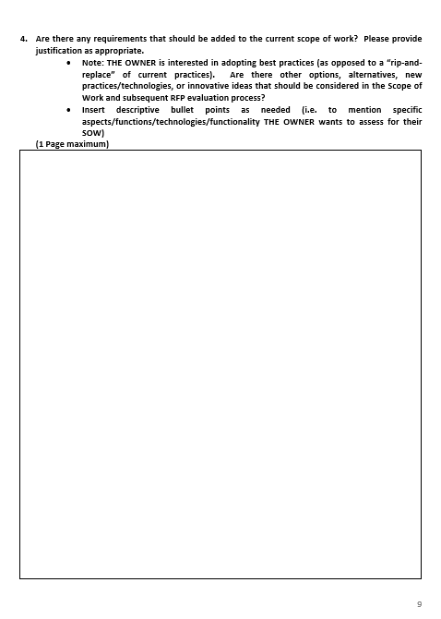
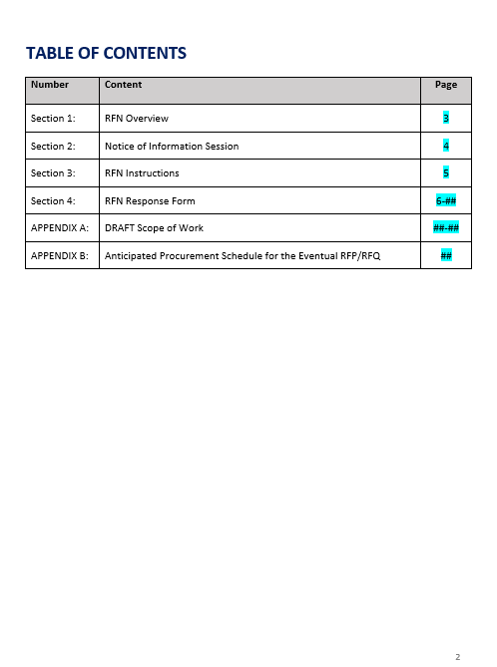
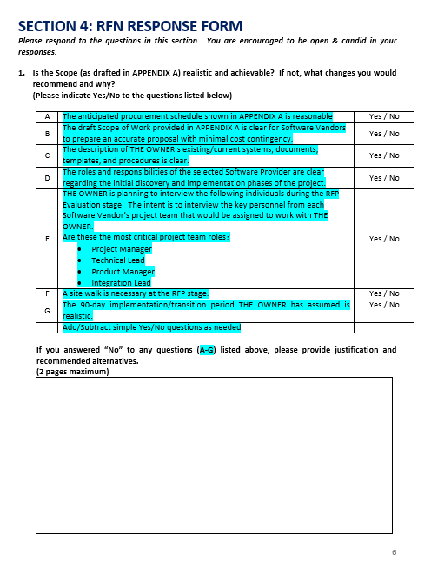


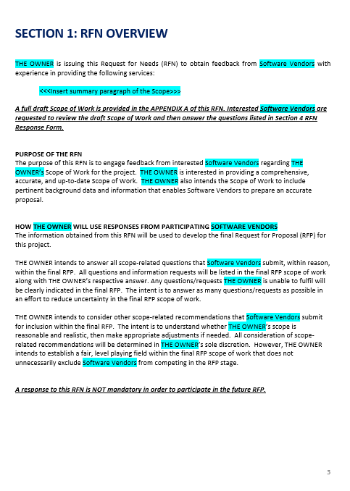
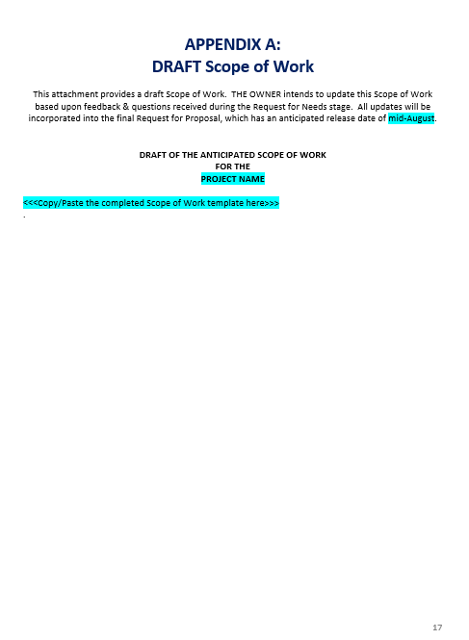
RFN Template

Slide 43
How to Prepare an RFN
Create the Scope of Work Sheet
  Emphasis on defining Current Conditions
  Include any objectives/requirements for the Future Conditions that will be different than Current
Use the RFN Template
  Copy/Paste the draft SOW
  Refine the RFN questions to meet project-specific needs
  Run the RFN in parallel with RFP development
  = NO TIME LOST!!!!

Slide 44
RFN Response – Critical Info
Vendor responses may inquire about…
Volumes, throughputs
Occupancy
Entry/Access
Rules/regs/restrictions
Schedules
Current practices / ops
Equipment condition
Current service levels
Stakeholder involvement
Etc…
Answer as much as you can
=
SOW complete!

Slide 45
RFN Example: Seattle City Light
RFN Process (in parallel with RFx Development)
Friday: created RFN (Draft Scope + RFN Template)
Monday: Seattle advertised the RFN
Following Monday: Vendors submitted RFN responses
Tuesday: “Action Item” list for Seattle’s project team
  Vendors even proposed re-written scope language!
Thursday: Seattle’s Project Team provided answers & documents
Friday: Released the final RFx with expert-augmented Scope

Slide 46
RFN Response – Example
Suggested wording for item B:
  "The Consultant shall issue an audit report performed in accordance with GAAS and provide 50 copies of this report, bound with the financial statements, to City Light. The Consultant shall issue an audit report performed in accordance with GAGAS and provide 25 copies of this report, bound with the financial statements and the report on internal control over financial reporting and on compliance and other matters, to City Light. The Consultant should deliver these audit reports to City Light's controller no later than April 30 of the year subsequent to the year for which the report is prepared in order to comply with bond covenants."

Slide 47
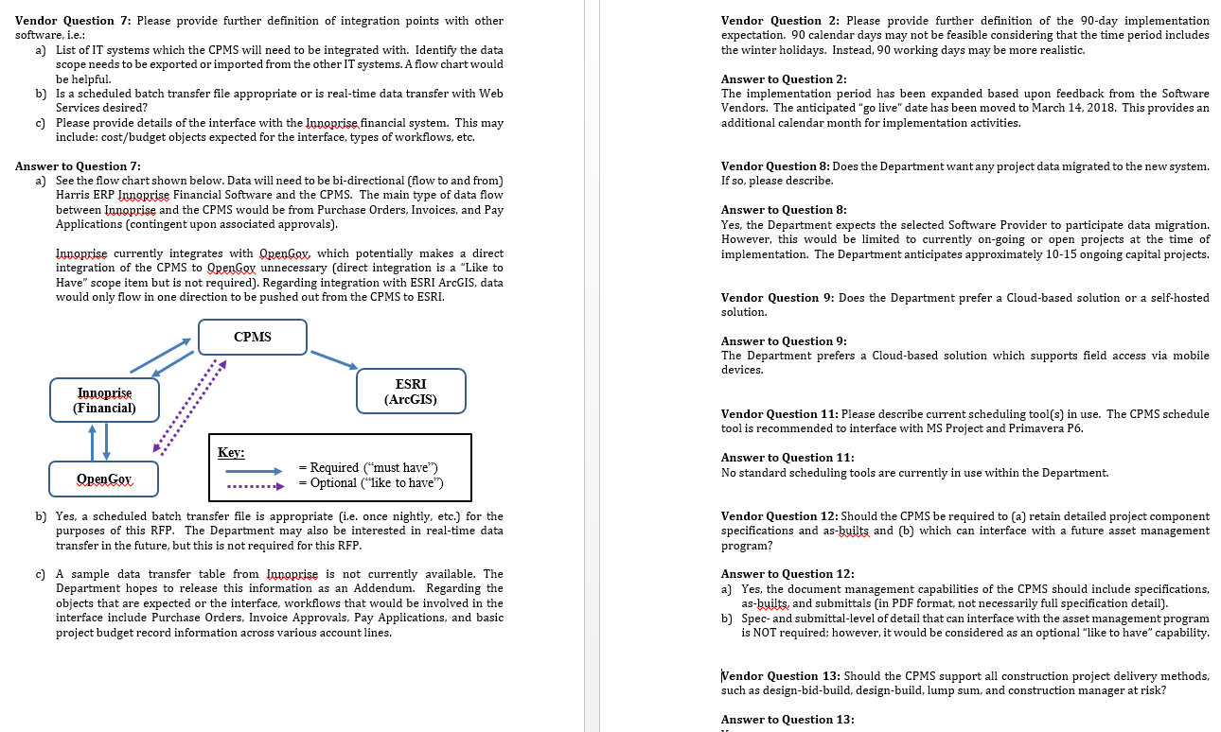
Enhancing the final SOW

Slide 48
Example:
$5M IT System RFN
Mon, Aug 20th = released RFN to vendors
  9 questions for vendors
Wed, Aug 22nd = info session for vendors
Tues, Sept 4th = Vendor RFN responses due
  6 vendors responded
  83 separate recommendations from Vendors on how to improve the scope (questions, gaps, clarifications, etc.)
  56 action items for Client team to prep for implementation
Wed, Sept 12th = release RFP (w updated SOW)

Slide 49
Sample Feedback

Slide 50
Recent RFN Results at Utilities
Building Analytics Software = 27pgs of content beyond traditional RFI
Capital Project Management Software = vendors helped clarify appropriate technical requirements
DSM Software = 67pgs vendor feedback on draft SOW
Annual Audit = 1 week turnaround including re-written scope clauses

Slide 51
Importance of an Accurate Scope of Work before the RFP
Licensing cost will be approximately $$ per year for YYYY licenses. Implementation cost could be X to 2X one time. This is a very rough estimate based upon what we know now.
A key success factor in determining the estimated timeline and roll out plan is understanding of the requirements. The overall implementation timeline depends greatly on the total scope of work, including the number and complexity of… compensation plans, calculation details, sales crediting processes, sample reports & dashboards, workflows, exception processes and more.
One-third of vendors recommend a one-on-one, detailed scoping session to understand requirements and implementation project plan.

Slide 52
Cost Drivers in IT
Implementation Cost is driven most significantly by:
Data Integration: breadth of data resources and integration complexity as well as the amount of specialized data acquisition and mapping
Data Migration: quantity and complexity
Approach: the approach to project management, level of customer engage
Testing Regime: how the testing is shared between the parties, number of cycles, other requirements
Workflows: ability to use standards vs. need to develop customer-specific
Level of Customer Engagement: availability of customer staff time and resources
Functionality: complexity of system and specific requirements (i.e. complexity of Comp Plans)

Slide 53
Cost Drivers in IT
Training Cost is driven by:
Volume: Number and type of users participating,
Type: Tools and approaches used (eLearning vs. on-site instructor-lead)
Ongoing Licensing / User Subscription Costs:
Users: Number and type of users
Functionality: Features/modules available to users

Slide 54
Request for Needs (RFN)
What is an RFN?
A process to help solidify your scope prior to RFP.
How does an RFN work?
Release a “draft” Scope of Work to the vendor community.
Get feedback from across the industry.
When should we use the RFN process?
Any time you are unsure of your scope.
All projects that require a software integration.
How long does an RFN take?
1 week to 1 month.
And can be done in parallel with RFP development.

Slide 55

This takes Training & Outreach to the Vendor Community

Slide 56

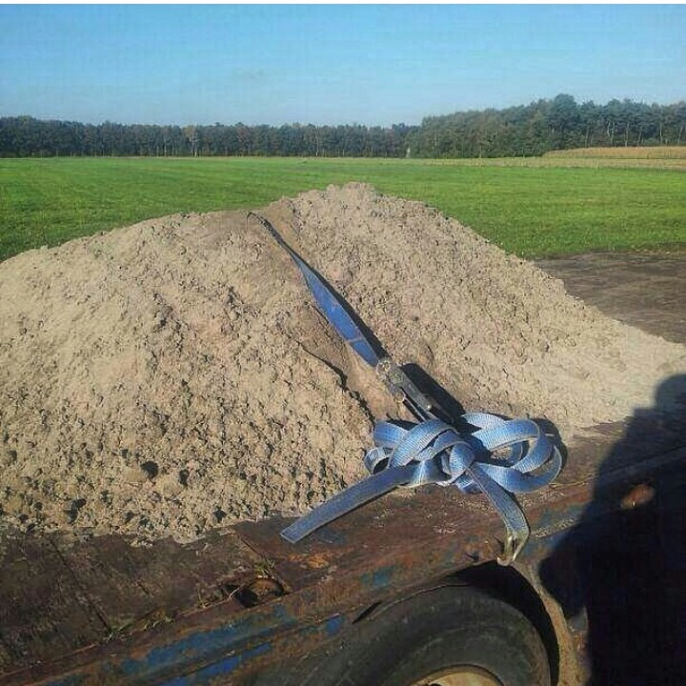
We’ve got it covered?
Don’t release and “hope for the best”

Slide 57
When in Doubt…Issue an RFN!!!
Leverage expertise from the industry to check:
Is our approach feasible?
What are realistic options?
What information do vendors need to prepare an accurate proposal with minimal contingency?
The Client DOES NOT need to know every detail!
Define current conditions
Define objectives / requirements / Scope
Leverage industry feedback
Notes:
ASU BOOKSTORE!!!

Slide 58
Scope Development
Share the Project’s Constraints
Don’t be Overly Prescriptive
Focus on Current Conditions
Include an appropriate Vision Statement
Ask Vendors what they Need
Take-Away Tools
White Paper on “The Budget”
SOW Template
RFN Template

Slide 59
Expertise-Driven Project Delivery (XPD)
CONTRACT
AWARD
0
SCOPE
DEVELOPMENT
SELECTION
PRE-AWARD
CLARIFICATION
PERFORMANCE
METRICS

Slide 60
Scope Definition vs. Proposal Variation
Scope Definition
Poor
Moderate
High
Variation in Evaluation Scores
N = 347 projects (1,850 individual proposals)

